Slide 1
Payment Flow Overview
July 21, 2023
Prepared by: Rohit Kherde
Email:rohitprakash.Kherde@nttdata.com

Slide 2
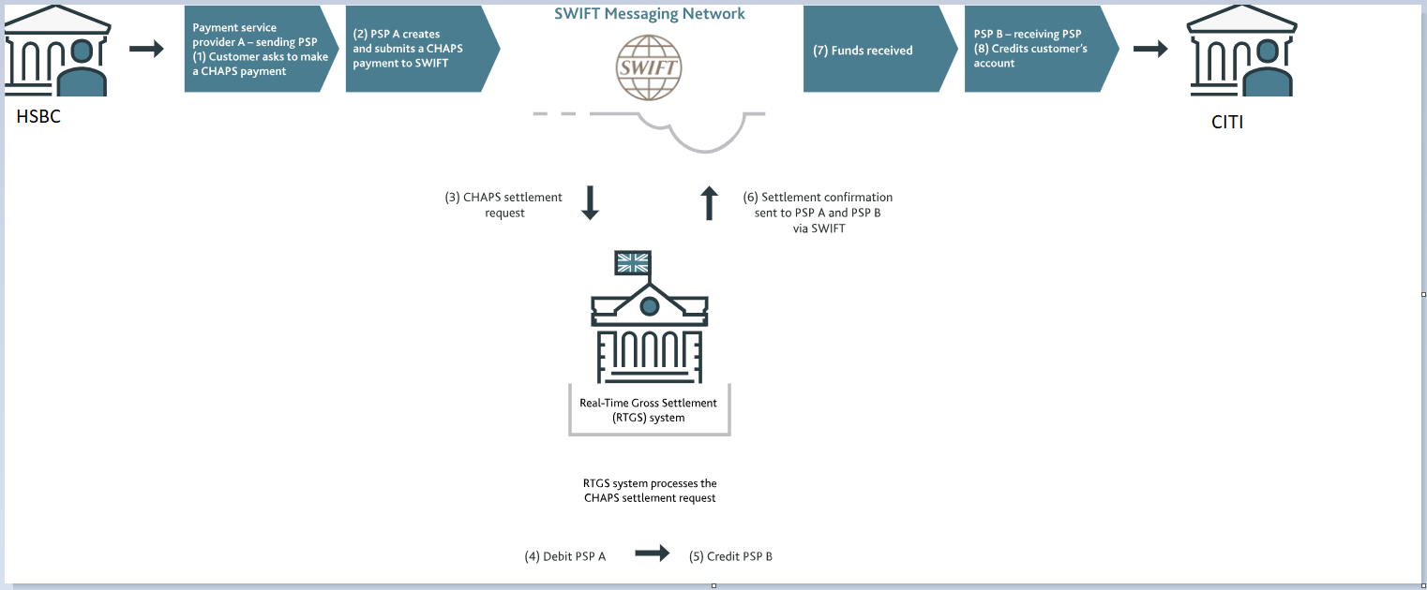
CHAPS Payment System

Slide 3
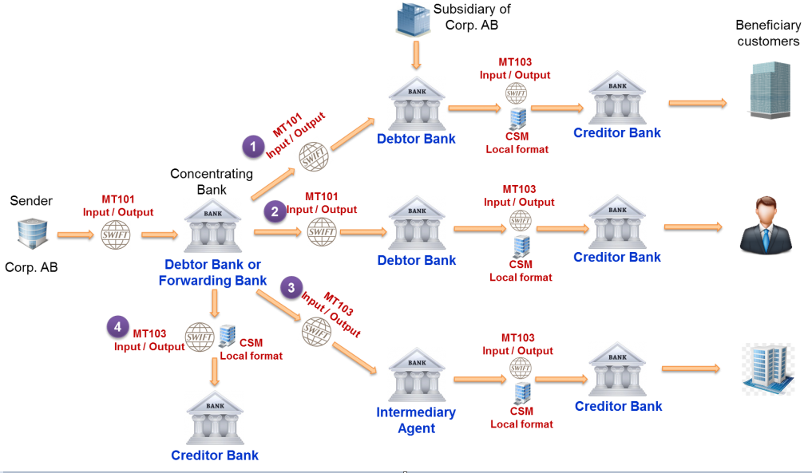
SWIFT MT Message Flow
Notes:
MT101(Message Type 101) is a request for transfer message send by bank on behalf of the customer to initiate a customer credit transfer
MT103 (Message Type 103) is a specific format used on SWIFT payment system to send cross border messages between financial institutions for customer cash transfers.

Slide 4
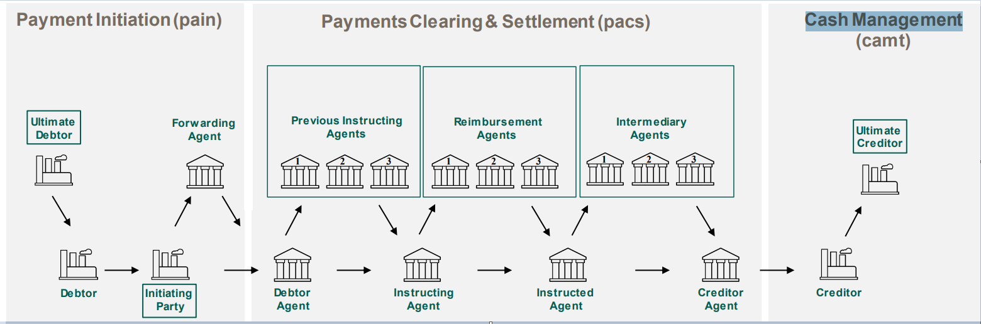
Payment Flow - ISO 20022

Slide 5
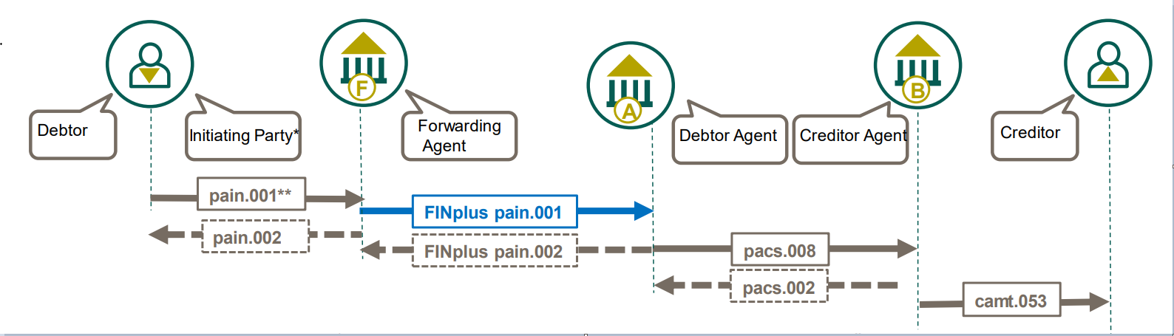
Payment Flow - ISO 20022 - Continue

Slide 6
Payment Flow Overview – SWIFT Alliance Messaging Hub
Customers/Banks needs to connect to SWIFT network to carry out transaction which can be done using AMH and SAG.
1) AMH - Alliance Message HUB - is a Messaging Interface which connect to payment system using ISO 20022-based financial messages. AMH is a platform that provide a gateway to payment system, as well as other gateways and APIs, allowing financial institutions to connect to other non-Swift networks. It provide both real-time and batch processing capabilities, supporting the low latency and integration requirements of all financial institutions.
2) SWIFTAlliance Gateway is a Communication Interface. It is a software package that is installed on top of SWIFTNet Link. It provide service such as message concentrator, receiving messages from various other applications for passage through SWIFTNet.
Four service which SWIFTAlliance provide:
a)SWIFTNet Messaging Services - provides secure and reliable exchange of individual structured
financial messages.
b)FIN - SWIFT FIN is a message type (MT) that transmits financial information from one financial institution to another.
c)Browse - Browse enables users to browse on financial online portals made available by financial institutions and market infrastructures on SWIFTNet
d)File Act - SWIFTNet FileAct provides secure and reliable transfer of files, such as batches of structured financial messages or large reports.

Slide 7
Payment Flow Overview - Payment Orchestration Platform
In order to integrate different payment service providers, acquirers, payment gateways and banks on a single platform Payment Orchestration Layer is used.
POL or Payments orchestration platforms (POPs) is a software that manages online payment processing from start to finish. This includes payment authorization, transaction routing, and settlements.
It is also used to integrate and manage various payment processor which enables financial transactions,
Example: commonly employed by a merchant, to handle transactions with customers from various channels such as credit cards and debit cards or bank accounts. It can also handle payment flows and payment processes such as reconciliation, billing and settlement, payouts and reporting.

Slide 8
Payment Flow Overview – Transaction Check/ Transaction Screening
The transaction Screening tool allows financial institutions to control the receiver and sender in global AML data transactions. With API integration, all controls take place automatically in seconds in the background.

Slide 9
Payment Flow Overview – Global Payment Service
Global Payment System –
1) A system used to settle financial transactions through the transfer of monetary value.
2) Global payment processing is the transfer of money to either a supplier, a vendor, an employee or a business affiliate, whose bank account is set up in a foreign country. Example: In order to pay employees abroad, the money must first be transferred to a local bank account then processed for payroll. This stage is facilitated by global payment processors who can make payments directly into employee bank accounts.

Slide 10
Glossary
SWIFT | Society for Worldwide Interbank Financial Telecommunications
MT 101 | Message Type 101 is a request for transfer message send by bank on behalf of the customer to initiate a customer credit transfer
MT 103 | Message Type 103 is a specific format used on SWIFT payment system to send cross border messages between financial institutions for customer cash transfers.
FINPlus | FINplus is Service that enables financial institutions to exchange the ISO 20022 messages for securities and payments in a secure, cost effective and reliable way.
pacs | Payment Clearing and Settlement
pain | Payment Initiation
Camt | Cash Management
pacs.008 | Credit Transfer
pain.002 | CustomerPaymentStatusReport
pain.008 | CustomerDirectDebitInitiation
camt.053 | BankToCustomerStatement
Debtor | Party that owes an amount of money to the (ultimate) creditor. In the context of the payment model, the debtor is also the debit account owner.
Creditor | Party to which an amount of money is due. In the context of the payment model, the creditor is also the credit account owner.
Ultimate Debtor | Ultimate party that owes an amount of money to the (ultimate) creditor.
Ultimate Creditor | Ultimate party to which an amount of money is due.
Debtor Agent | Financial institution servicing an account for the debtor.
Creditor Agent | Financial institution servicing an account for the creditor.
Forwarding Agent | Financial institution that receives the instruction from the initiating party and forwards it to the next agent in the payment chain for execution.
Initiating Party | Party initiating the payment to an agent. In the payment context, this can either be the debtor (in a credit transfer), the creditor (in a direct debit), or a party that initiates the payment on behalf of the debtor or creditor.
Account Owner | Party that legally owns the account.
Account Servicer | Party that manages the account on behalf of the account owner, that is manages the registration and booking of entries on the account, calculates balances on the account and provides information about the account.
Payment Clearing Agent (Instructing Agent) | Agent that instructs the next party in the payment chain to carry out the payment/instruction.
Payment Settlement Agent Instructed Agent) | Agent that executes the instruction upon the request of the previous party in the chain (either an agreement party, or a clearing agent).
Intermediary Agent | Agent between the debtor's agent and the creditor's agent. There can be several intermediary agents specified for the execution of a payment.

